Slide 1
IAN MITCHELL
SCHOLARSHIPS
2019

Slide 2
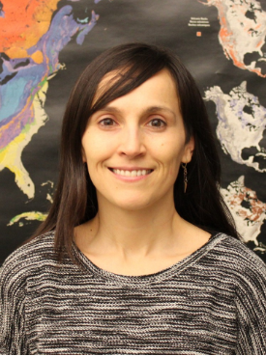
Zidra Hammond
Master of Science (Earth Sciences), SFU
Evaluation of the impacts of lithologic heterogeneity on groundwater flowpaths and the lateral and vertical extent of natural confining barriers at the regional scale using 3D visualization.
www.csapsociety.bc.ca | ©Copyright 2019. Society of Contaminated Sites Approved Professionals of British Columbia.

Slide 3
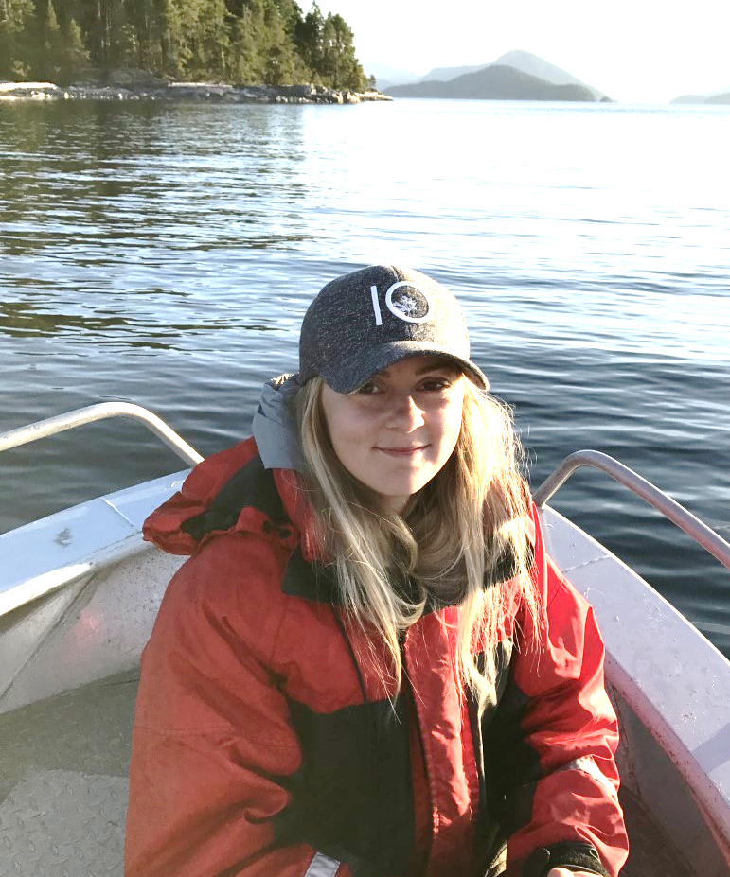
Lindsay Woof
Master of Environmental Toxicology, SFU
Understanding the impacts of chemicals used for aquaculture on marine habitats, including research on the toxicity of chemotherapeutants to Pacific marine species.
www.csapsociety.bc.ca | ©Copyright 2019. Society of Contaminated Sites Approved Professionals of British Columbia.

Slide 4
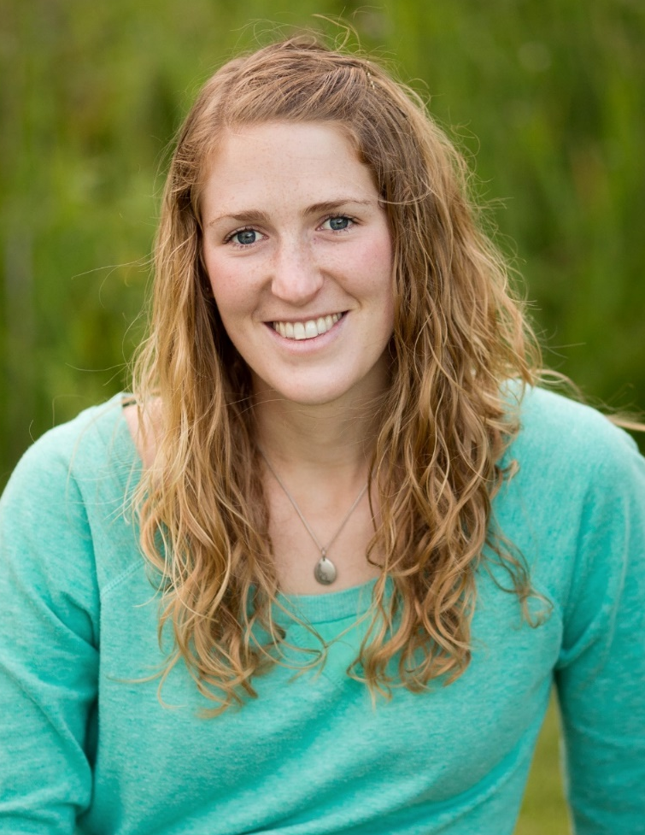
Katie McMahen
PhD Forestry, Dept of Forest and Conservation Science, UBC
Mike Macfarlane Award Recipient
Understanding how soil organisms can enhance vegetation resilience to contamination;
Evaluating remedial methods for promoting recolonization of potentially beneficial soil organisms on contaminated sites; and
Understanding the physiology and ecology of where and how plants obtain resources within the soil profile to evaluate the risk control of placing restrictions on deep rooting plants.
www.csapsociety.bc.ca | ©Copyright 2019. Society of Contaminated Sites Approved Professionals of British Columbia.

