Slide 1
Economic Update
CSAP Society
Tim Collins & Nicholas Mackay

Slide 2
Agenda
Economic Update
Canada
Key Economic Data
Debt Exposure
Debt Expectations
Growth Outlook
Dollar – Range Bound?
US
Key Economic Data
Growth Outlook
North America
Expect Volatility
The Bottom Line

Slide 3
Canada

Slide 4
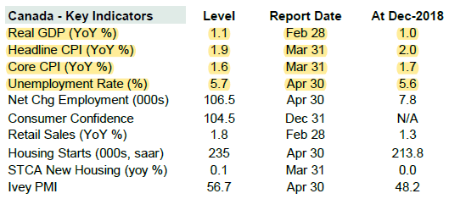
Key Economic Data

Slide 5
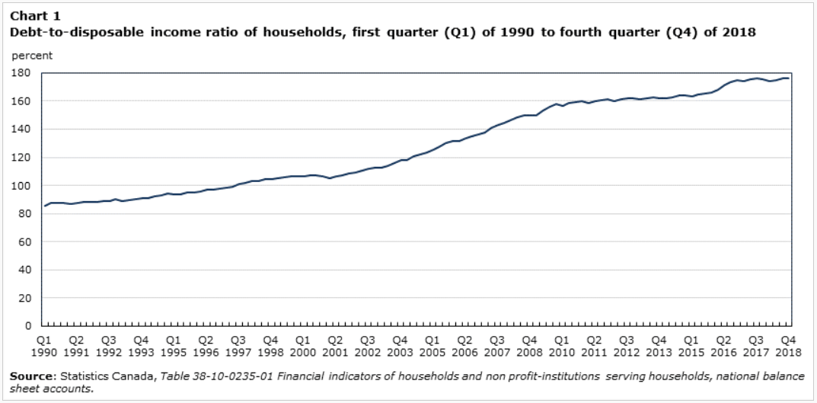
Debt Exposure
Source: Chart – Statistics Canada

Slide 6
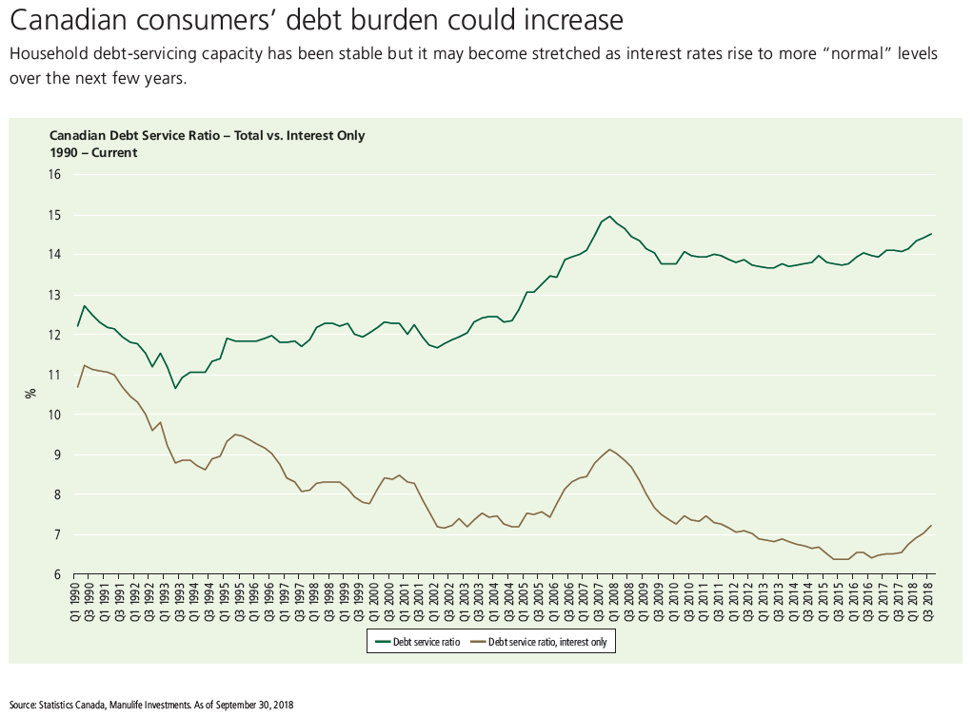
Debt Exposure Continued…
Source: Chart - Manulife Investments

Slide 7
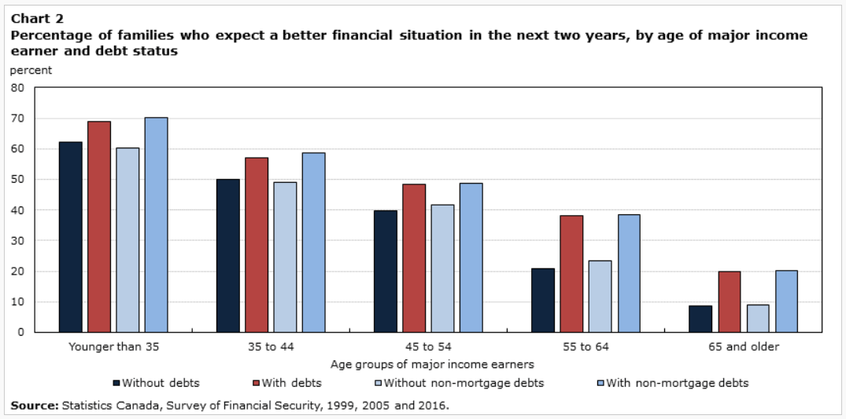
Debt Expectations
Source: Chart – Statistics Canada

Slide 8
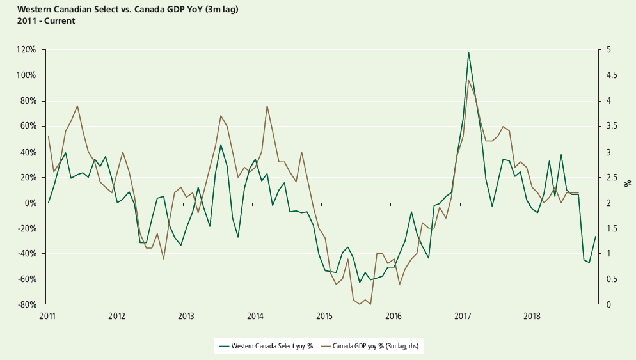
Growth Outlook
Source: Chart - Manulife Investments

Slide 9
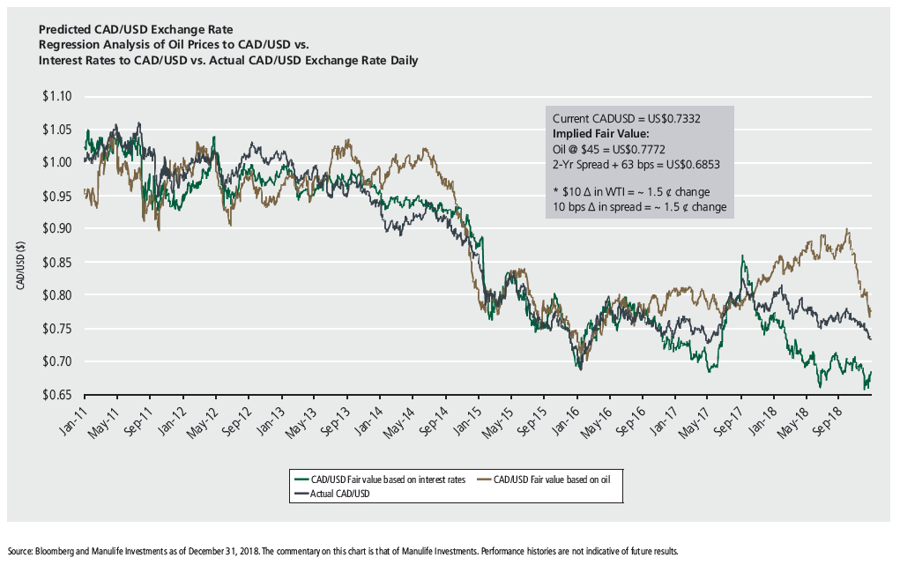
Dollar – Range Bound?
Source: Chart - Manulife Investments

Slide 10
US

Slide 11
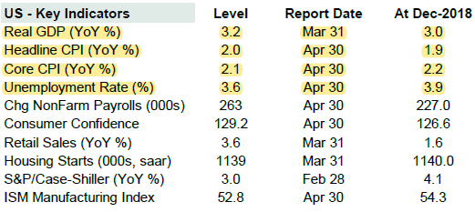
Key Economic Data

Slide 12
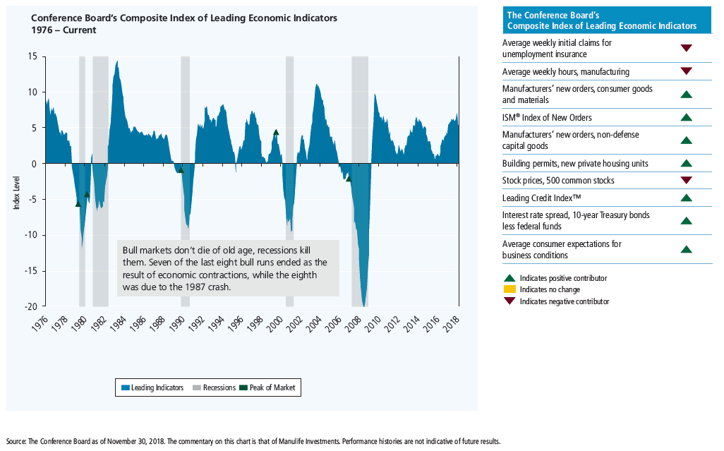
Growth Outlook
Source: Chart - Manulife Investments

Slide 13
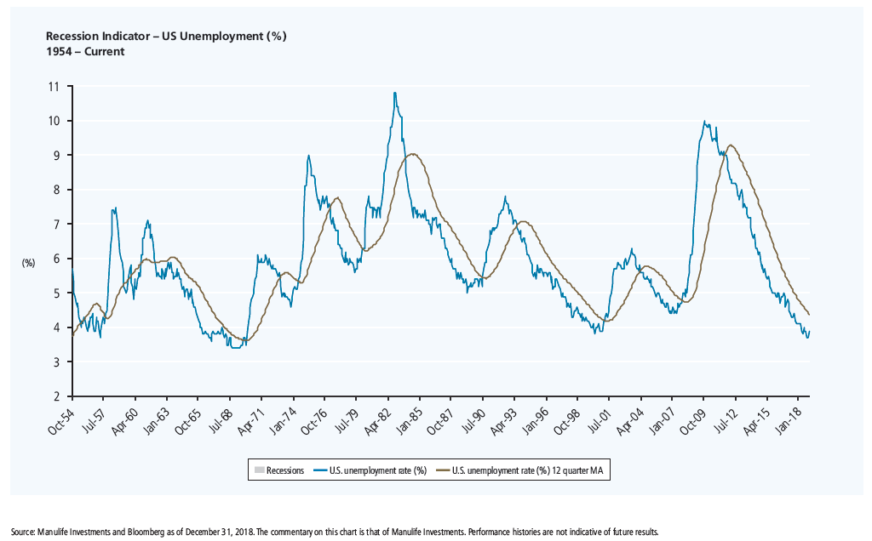
Growth Outlook Continued…
Source: Chart - Manulife Investments

Slide 14
North America

Slide 15
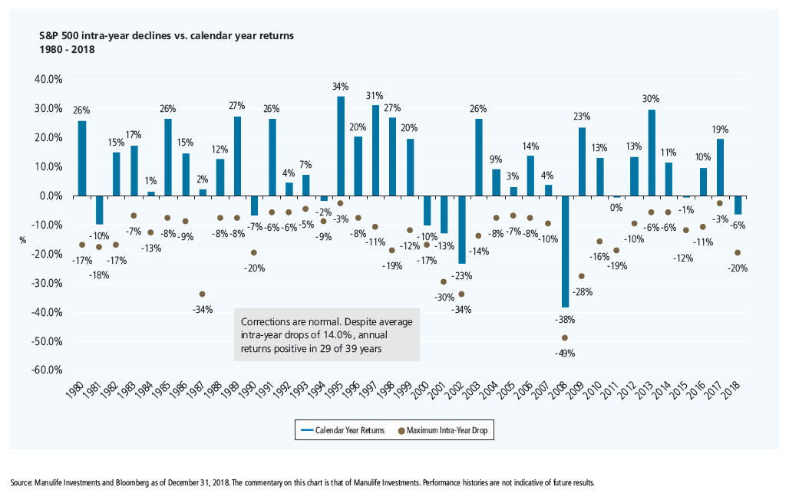
Expect Volatility
Source: Chart - Manulife Investments

Slide 16
The Bottom Line

Slide 17
Canada & British Columbia
Interest rates – lower for longer
Without a contraction in the US the risk of a recession is low in Canada
Expect continued volatility
Local considerations

