Slide 1
Guidance for the Assessment and Remediation of PFAS in BC
CSAP Workshop
October 2019

Slide 2
Overview
Introduction - PFAS of focus in BC
Regulatory Framework
Potential Sources
Laboratory Analysis
Site Investigation Considerations
Remediation Considerations
Notes:
Here’s an outline of the items I’ll cover in the next 25 minutes or so. Unfortunately, the author of our new Guidance document, Lindsay Paterson, couldn’t be here today so I’ll do my best to fill her shoes. The intent of this presentation is to provide you with an overview of the information available in this new CSAP resource and to highlight some of the key takeaway messages in it. The document was just finalized in May of this year and it’s currently available for download on the CSAP website.
Before delving into this, I’d like to first acknowledge the valuable contributions made by external reviewers, including:
Lavinia Zanini and James Plett from the BC Ministry of Environment,
Jo-Ann Aldridge from Indigenous Services Canada
Rita Mroz from Environment & Climate Change Canada; and
David Genereax from the North Carolina State University

Slide 3
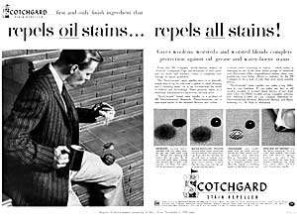
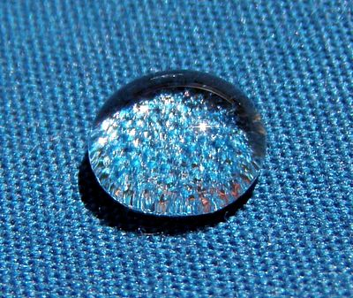
What are PFAS?
They are a family of man-made chemicals that have been used in a wide variety of industrial and consumer products and in specialized applications.
Notes:
For those of you who aren’t familiar with PFAS, they’re a group of man-made chemicals that have been used in manufacturing a wide variety of consumer and industrial products, such as cosmetics, ski waxes and all manner of water-, stain- and oil repellency products applied to fabrics and paper (such as carpets, clothing, pizza boxes, etc.) PFAS have also been used in specialized applications such as in metal plating fume suppressants and as components of firefighting foams.

Slide 4
PFAS
Perfluoroalkyl Substances
Polyfluoroalkyl Substances
(Precursors)
can degrade to
Perfluorinated Alkyl Acids
Perfluoroalkyl Sulfonates/Sulfonic Acids
Perfluoroalkyl Carboxylates/Carboxylic Acids
PFBS
PFOS
PFOA
CSR Regulated Parameters
Notes:
The term PFAS encompasses a very large group of chemicals – in fact, there’s thousands of them – this includes both PERfluoroalkyl substances and the POLYfluoroalkyl substances. The PERfluoroalkyls are chemicals that are comprised of a carbon chain where the carbons are fully fluorinated. POLYfluoroalkyls have carbon chains that are only partially fluorinated.
In BC, it’s only a particular subset of PFAS called the perfluoroalkyl acids that are the focus of regulation under the CSR. The acids can be further subdivided based on the end group associated with the chemical – whether a carboxylic acid or a sulfonic acid. The three individual PFAS regulated under the CSR are circled here. PFBS/perfluoro-butane sulfonate, PFOS/perfluoro-octane sulfonate and PFOA/perfluoro-octanoic acid.
As well, in the upper right hand portion of the slide, you’ll see that I’ve included the term precursors. This refers to chemicals that have the potential to degrade to the perfluoroalkyl acids, which don’t transform any further in the environment.

Slide 5
Naming reflects number of carbons and end groups on molecules
Number of carbons | Carboxylate End Group | Sulfonate End Group
C4 | PFBA | PFBS
C5 | PFPeA | PFPeS
C6 | PFHxA | PFHxS
C7 | PFHpA | PFHpS
C8 | PFOA | PFOS
C9 | PFNA | PFNS
Notes:
Although there’s only 3 individual PFAS regulated under the CSR, it’s a good idea to be aware of other related perfluoroalkyl acids as these are expected to co-occur with the regulated compounds at contaminated sites in BC, and there’s a good chance that they may also be regulated in the future.

Slide 6
Perfluoroalkyl Acids (PFAAs)
Persistent – fully fluorinated part doesn’t break down in nature (no biodegradation, no volatilization)
Bioaccumulative – some PFAS accumulate in tissues of higher trophic level biota
Toxic – known human and ecological health effects
Mobile – generally in anion form, contaminant plumes can be large
Notes:
So why is the regulatory focus on the perfluoroalkyl acids? This is because they are:
Persistent - meaning they are highly resistant to common degradation processes in the environment. This is mainly due to the strength of the carbon-fluorine bonds in the chemicals;
Some of the acids have been demonstrated to bioaccumulate
Some of the acids have known human and ecological health effects.
And finally, although some of the PFAS may have an affinity for organic carbon and iron oxides in the soil, they are quite mobile in the aqueous phase and so contaminant plumes can be large.

Slide 7
Provincial Regulatory Framework
BC Contaminated Sites Regulation – November 2017
PFBS: soil (human soil ingestion), groundwater (drinking water)
PFOA: groundwater (drinking water)
PFOS: soil (full matrix), groundwater (aquatic life and drinking water)
Notes:
Fourteen PFAS were originally identified as high priority substances by the Ministry in 2016 and 2017 during the development of the omnibus standards. However, standards were only derived for 3 of these chemicals based on the availability of toxicological information from specific sources such as the EPA at the time.
Soil standards have been developed for 2 of the chemicals, drinking water standards have been developed for all three chemicals and an aquatic life protective groundwater standard has been released for PFOS only.

Slide 8
???
Notes:
But all of these standards only apply to a site used for an industrial or commercial activity listed as either an A4, C3, E10 or G1 use in Schedule 2 of the Contaminated Sites Regulation.

Slide 9
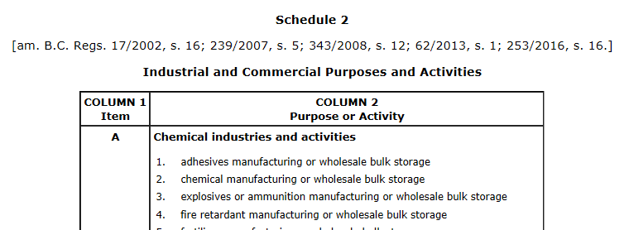
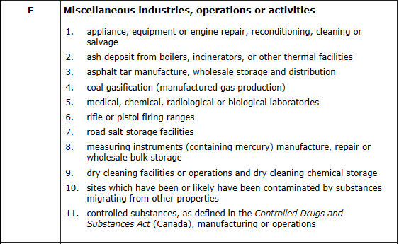
Notes:
So what are these uses?
A4 is related to fire retardent manufacturing and wholesale bulk storage
C3 is related to metal plating and finishing
G1 appears to be designed to capture airports which we now know are potential points sources of PFAS in the environment; and
E10 is a clever inclusion that covers sites which have been or likely have been contaminated by substances migrating from other properties. We’ve been told by the Ministry that, as the standards are written, it does not appear that E10 applies only where A4, C3 and G1 uses have occurred at the source site.

Slide 10
Notes:
Schedule 2, use A4, is linked to fire retardant manufacturing and wholesale bulk storage, presumably to capture sites at which aqueous film forming foams or other fluorine-containing foams were stored, handled or used in large quantities. It should be noted that A4 refers to WHOLESALE bulk storage and not simply bulk storage. This may be a gap that the Ministry intends to address down the road based on the description of wholesale bulk storage provided in Administrative Guidance document 13.
However, not all areas where firefighting chemicals were stored or used, will be sources of PFAS. These chemicals are associated with flammable liquid or Class B fire-fighting foams. Forest fire-fighting chemicals are generally comprised of Class A fire extinguishing materials and are not expected to be sources of PFAS.

Slide 11
Other Regulatory Efforts
Health Canada
Guidelines for Canadian Drinking Water Quality (PFOS and PFOA only) – December 2018
Drinking Water Screening Values – April 2019 (FTS update)
Soil Screening Values - May 2019 (FTS update)
CCME
Draft Canadian Soil and Groundwater Quality Guidelines for PFOS - issued for public comment in August 2018
ECCC
Federal environmental quality guidelines for PFOS – June 2018
Notes:
The guidance document also touches on efforts elsewhere, whether federally by Health Canada and Environment and Climate Change Canada or internationally. These are provided in the document as a starting point for further inquiry by BC- based practitioners due to the likelihood that investigators will encounter a wider array of PFAS at contaminated sites than the 3 regulated parameters.
It’s my understanding that some of the non-regulated PFAS may get reviewed in the next cycle of standards by the BC Ministry, so they may very well be substances that are regulated provincially in the future. In addition, it’s important to explain the current regulatory status and what we know about the toxicity of these other PFAS chemicals to our clients, in order to help them make informed decisions on how to proceed based on the best available science.
Health Canada has derived drinking water guidelines for PFOS and PFOA – these were released nearly a year ago. They’ve also developed drinking water screening values for PFBS and 8 other PFAS that are not currently regulated under the CSR.
CCME has developed draft soil and groundwater quality guidelines for PFOS but have not finalized these. Environment and Climate Change Canada has developed guidelines for PFOS in surface water (protective of direct contact only) and for various biota tissues.

Slide 12
International Efforts
Stockholm Convention:
PFOS – Annex B
PFOA - Annex A
PFHxS - under consideration
Basel Convention
Guidelines for management of PFOS-containing wastes
50 mg/kg threshold
Notes:
Internationally, PFAS are recognized as an environmental issue. Two PFAS are now listed in the Stockholm Convention, with a third PFAS (that’s’ not currently regulated under the CSR) under consideration for inclusion. Guidelines for the environmentally sound management of PFOS-containing wastes have been developed under the Basel Convention (with hazardous levels defined by a PFOS content of 50 mg/kg in the wastes).
The BC guidance document also touches on regulatory efforts in other countries and summarizes available guidelines for media and exposure route combinations not considered for the CSR-regulated parameters, as well as guidelines for non-regulated parameters. Since the regulatory regimes internationally are constantly changing, these values are simply provided as a starting point for further inquiry - and caution should be used in referring to the values as some of them may have been revised or superceded in the short time since the guidance document was released.

Slide 13
Schedule 2 Sources
AFFF (& other fluorine-containing foams)
Equipment test locations (daily, weekly, monthly, annual)
Emergency vehicle filling and maintenance areas, fire halls/stations
AFFF bulk storage, drum disposal areas and charged suppression systems
Crash sites and fuel spills
Flammable liquid fires (e.g. fuel storage tanks, fuelling areas)
Notes:
The guidance document reviews the point sources of relevance under the BC regulatory regime. Areas where emergency response personnel would have trained with the use of PFAS-containing firefighting foams are potential point sources of PFAS. Frequently, these have been situated at airports, for obvious reasons. However, firefighting training areas are not the only locations where these foams may have been historically released. Other areas to consider in regards to release of firegfighting foams are listed here.
In particular, foams will have been used to prevent ignition of flammable liquids during fires and spills. To that end, foams could have been deployed at non-airport sites such as large scale petroleum facilities. However, as noted earlier, given that the A4 Schedule 2 use refers to wholesale bulk storage of fire retardents, it is unclear whether storage and deployment of fluorine-containing foams at petroleum facilities are captured by the Schedule 2 uses linked to the PFAS standards. Regardless the Environmental Management Act prohibits the creation of pollution, so this may be a minimal gap in reality.

Slide 14
Metal Plating
PFAS in products used to suppress volatilization of hexavalent chromium (e.g. Fumetrol), added to plating baths
Notes:
Other well known specialized applications of PFAS include their use as fume suppressants for the metal plating industry, particularly in the hard chrome plating industry, where they have been used for health and safety purposes to help minimize worker exposure to hexavalent chromium vapours.
Data from groundwater collected at one chrome plating facility is shown here. It clearly demonstrates that use of such products can result in the release of PFAS to the subsurface at concentrations exceeding regulatory limits, in this case the drinking water standard for PFOS.

Slide 15
Aviation Hydraulic Fluids
PFAS used to prevent corrosion and fires
Limited information on PFAS content and type of PFAS potentially present in aviation hydraulic fluids
Notes:
The guidance document also summarizes the available information on the presence of PFAS in other aviation products that could be captured under the Schedule 2 uses associated with the CSR PFAS standards (specifically G1 aircraft maintenance, cleaning and salvage).

Slide 16
Sources not listed under the CSR
Landfills
Wastewater treatment facilities
Wastewater lagoons
Biosolids application areas
Notes:
Finally, other sources of PFAS that practitioners should consider in terms of influence of concentrations at investigation sites are provided in the guidance document. These include landfills, wastewater treatment plants and lagoons and areas where biosolids have been applied. Biodegradation processes in wastewater treatment plants are not effective at reducing PFAS concentrations.

Slide 17
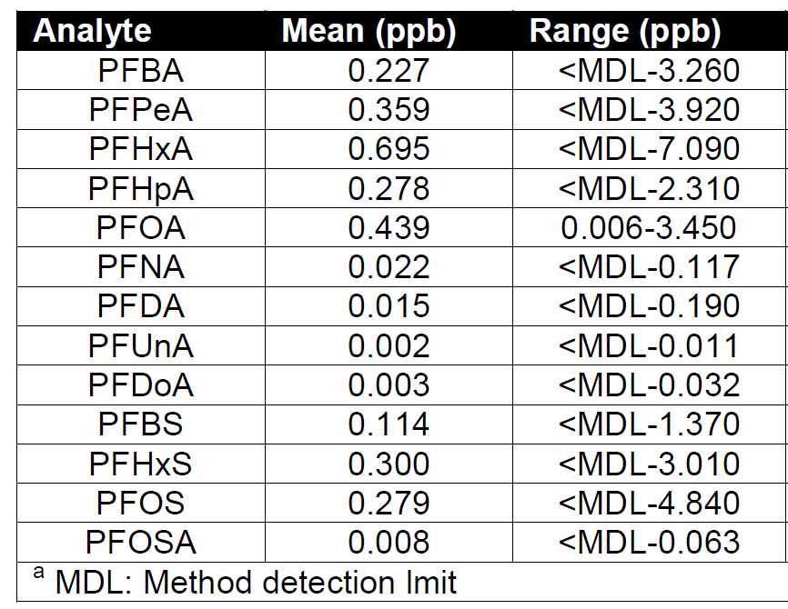
Mean PFAS Concentrations in Cross-Canada Landfill Leachate Source: Belinda Li, MASc thesis
C4-C12
Perfluoro
Carboxylates
C4-C8
Perfluoro
Sulfonates
Notes:
This slide shows that perfluoroalkyl acids such as PFOS and PFOA have been measured in Canadian landfill leachate at concentrations above the CSR drinking water standards.

Slide 18
BC Environmental Laboratory Manual
Notes:
Shifting gears to laboratory considerations for investigations in BC: two methods for analysis of perfluoroalkyls in soil and in water were released by BC Environment in 2017. However these methods outline performance based requirements and are not prescriptive analytical procedures per se.
Site investigators should be aware that all labs employ an in-house developed method. From lab to lab, there will be differences in aspects of their methods.
Of particular note in the lab manual are the requirements for the handling of sediment in aqueous samples. Specificially, PFAS associated with sediment in water samples is to be extracted separately with the associated results being reflected in the final reported concentrations. This is not what has historically been done by the commercial labs.
The lab manual also requires that labelled PFBS, PFOA and PFOS quantification standards be used at a minimum. Practitioners should be checking to confirm that their project lab is using a labelled standard for PFBS.
As well, the lab manual also specifies hold times that may be shorter than those specified in the lab’s own in-house method.
The take home message is that the requirements for analysis of PFAS on lands under provincial jurisdiction may not be met by the in-house method being offered by the lab conducting the analysis. To that end, it is imperative that project managers liaise with the labs prior to sample collection and analysis to confirm that the method being employed will meet BC regulatory requirements.

Slide 19
Site Investigation Considerations
Site-Specific Considerations
Surface runoff and stormwater transport
Groundwater-surface water interactions
Proximity of water supply wells
Receptor Identification
Consider persistence and mobility (transport distances can be significant)
Expedite investigations where potential for DW consumption (“Outside-In approach”)
Media of interest:
Regulated media: soil, groundwater
Media to be considered with risk-based approach: sediment, surface water, drinking water, dust, biota tissues (human and eco food items)
Notes:
The guidance document highlights a number of key considerations for site assessment of PFAS.
These include site-specific factors such as understanding interactions between surface soil and precipitation, irrigation water and/or surface runoff due to the frequent release of PFAS-containing materials to surface soils at some source sites (e.g., as a result of AFFF application or spillage).
Also, understanding groundwater-surface water interactions such as seasonally inundated conditions and potential for discharge to surface drainages (particularly in British Columbia coastal areas) and finally, understanding of other factors that may affect groundwater transport processes, including presence, depths and pumping rates of water supply wells in the vicinity of the source.
Given the potential for extensive groundwater and surface water transport of perfluoroalkyl acids, site investigators should give consideration to potential receptors at significant distances removed from source areas. PFAS may travel in groundwater for several kilometres (and hundreds of kilometres in surface water) from the source location. For these reasons, it is also recommended that PFAS investigations be expedited where there is a potential for impacts to off-site receptors, particularly drinking water consumers (what is called an “outside-in” approach).
Due to the partitioning behaviour of the regulated PFAS and the availability of BC CSR numerical standards, both soil and groundwater are considered media of interest. Additional media which may be of interest with respect to the application of BC CSR risk-based standards, as well as for due diligence purposes, include surface water, drinking water, dust, sediment and biota tissues.

Slide 20
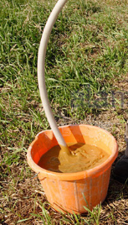
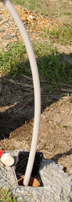
Field Precautions Or The Birthday Suit Well Development and Sampling Protocols
Notes:
If you’ve attended other presentations about PFAS in the past, you’ll know that there are so many field precautions to be considered during PFAS site assessments, and so many types of clothing material that could potentially give rise to false positives that this may very well be the best sampling protocol for PFAS in the future!

Slide 21
Field Precautions
Materials to avoid
Acceptable materials
Water sources for investigation programs
Equipment Decontamination
Other Field Considerations
Notes:
Seriously though, to provide an appreciation of how sensitive the QA/QC issues are with PFAS compounds, consider that we’re used to working with contaminants that are regulated in the parts per million or parts per billion, while some of the PFAS compounds are regulated in the parts per trillion!
By analogy, if you were to drink water laced with PFOA equal to its standard - and if you drank eight, 8-ounce glasses of that water 365 days a year for a lifetime of 80 years - you’ll have consumed only about 3 or 4 drops of PFOA!
So as a site investigator, the challenges associated with the characterization of PFAS contaminated sites start at the project planning and initiation stage. Due to the prevalence of PFAS or PFAS-related compounds in a variety of consumer materials, as well as the surface activity of these compounds, investigations require specialized precautions above what is considered the norm, and these need to be accounted for during the design and planning stages of investigation.
Many of the materials that we normally use are unacceptable when investigating for PFAS due to the potential for introduction of low levels of the contaminants. The guidance document provides a compilation of materials to be avoided in field programs and materials that are considered acceptable. It also reviews considerations for pre-testing water sources used in assessment programs (whether for collection of QA/QC blanks or for the decontaminating equipment, which can be incredibly onerous, especially when working in source areas.
The guidance also lists specific considerations for a number of other items, including drilling, well development, and sampling of soil, groundwater, surface water, sediment and drinking water.

Slide 22
QA/QC
Blanks
Blanks
And more blanks
Notes:
The importance of analyzing blanks during PFAS site assessments can’t be over-emphasized. From the measures necessary to prevent cross-contamination in the field during drilling, soil sampling, groundwater monitoring and water sampling, to those measures necessary to tease out potential cross-contamination at the lab, you need to analyze blanks and lots of them.
The guidance document reviews a number of other QAQC considerations, including laboratory detection limits and laboratory QAQC metrics. From experience, it is critical to consider the lab data in consideration of what you know about the conceptual site model. If the data isn’t making sense within the CSM, then there is a decent chance that it may be related to cross-contamination or introduction of PFAS to samples from other sources.

Slide 23
Remediation
Resists biodegradation
Resists photolysis, hydrolysis
Destroyed at ~1000˚C
Non-volatile
Large dissolved phase groundwater plumes
Sorption, solubility differences
Notes:
The guidance document also reviews field-proven remediation options for both soil and water.
This slide focuses on the unique properties of PFAS that make them highly resistant to environmental degradation and pose challenges for remediation.

Slide 24
Remediation
Source: Minnesota Pollution Control Agency
Notes:
In places like Minnesota where large sources of PFAS have been identified, the regulators have taken the approach of excavating source materials and placing them in engineered cells. In BC, this would require a waste discharge authorization from the Ministry.
Other options for soil include incineration, but the associated cost is prohibitive in terms of larger scale source removal.
Some companies are advertising incorporation of proprietary soil additives to sorb and stabilize PFAS but the long-term efficacy of such materials is still under evaluation. Other trials are being conducted using soil washing and in situ chemical oxidation but have their own challenges. In particular, ISCO is not known to be effective on perfluoroalkyl sulfonates and may actually result in the generation of more mobile PFAS from precursors.

Slide 25
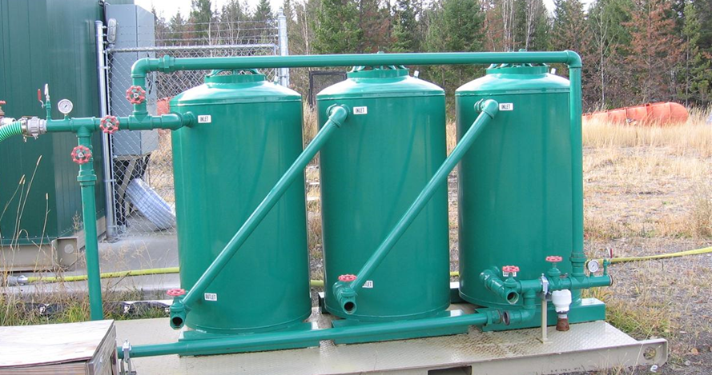
Remediation Considerations
Notes:
Because the dissolved phase groundwater plumes can be large, it’s often more practical to target source removal and then end-point treatment rather than attempting to remediate the entire plume to very low target levels.
The majority of groundwater remediation research has been focused on pump and treat methods with optimization of removal on sorbent media (such as granular activated carbon or other media such as ion exchange resins) or by filtration methods (Reverse Osmosis, nanofiltration). In Australia, foam fractionation is being used by the Dept of Defence at one of their sites. With foam fractionation, air is used to promote the migration of PFAS to a foam phase. The foam then gets extracted and further reduced. A sorbent technology is usually still required to reduce PFAS concentrations to levels that are suitable for discharge. But it may be useful in extending the life of the sorbents. The generation of a high concentration foam waste could be significant though, depending on how much water requires treatment on a daily basis.

Slide 26
Thank You!
Ian Mitchell, SLR Consulting (Canada) Ltd.
imitchell@slrconsulting.com
250.413.4712
Lindsay Paterson, SLR Consulting (Canada) Ltd.
lpaterson@slrconsulting.com
778.760.1786

