Slide 1
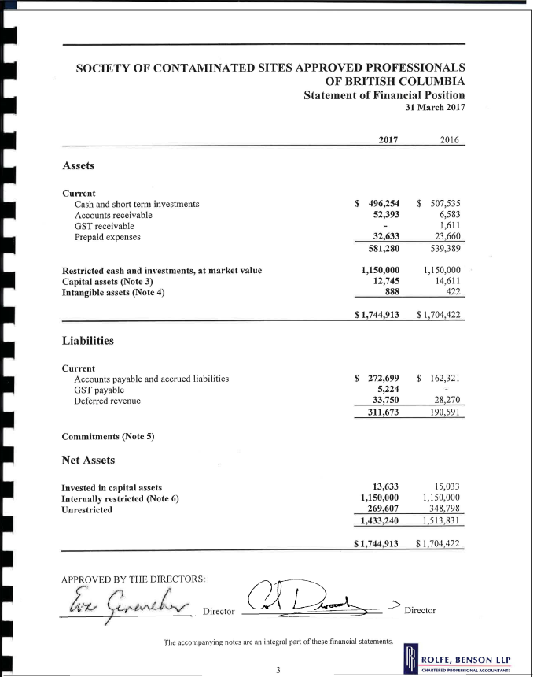
3. FINANCIAL STATEMENTS 2018-2019
~ Andrew Sorensen, Secretary / Treasurer
Approval of the Financial Statements (Attachment ll):
www.csapsociety.bc.ca | ©Copyright 2019. Society of Contaminated Sites Approved Professionals of British Columbia.

Slide 2
4. APPOINTMENT OF THE AUDITOR
Rolfe, Benson LLP
www.csapsociety.bc.ca | ©Copyright 2019. Society of Contaminated Sites Approved Professionals of British Columbia.

Slide 3
5. ELECTION OF THE 5 AT LARGE DIRECTORS
CSAP Bylaws allow for a total of 12 Directors.
3 are representing our parent organizations:
Eva Gerencher, representing BCIA
Tony Gillett, representing APEG BC
Beth Power, representing CAB
3 are appointed by ENV:
Andrea Akelaitis, environmental representative
Anne Bancroft-Jones, representing industry
Patrick Johnstone, representing local government
Representing ENV
Vince Hanemayer
www.csapsociety.bc.ca | ©Copyright 2019. Society of Contaminated Sites Approved Professionals of British Columbia.

Slide 4
5. ELECTION OF THE 5 AT LARGE DIRECTORS
Today we will be electing the 5 at–large Directors
Please refer to your ballot, there should be a line to include nominations from the floor
Call for nominations from the floor
www.csapsociety.bc.ca | ©Copyright 2019. Society of Contaminated Sites Approved Professionals of British Columbia.

Slide 5
5. ELECTION OF THE 5 AT LARGE DIRECTORS
Introduction of Candidates:
Patty Carmichael | Trish Miller
Chuck Jochems | Guy Patrick
Duncan Macdonald | Tara Siemens-Kennedy
www.csapsociety.bc.ca | ©Copyright 2019. Society of Contaminated Sites Approved Professionals of British Columbia.

Slide 6
5. ELECTION OF THE 5 AT LARGE DIRECTORS
Please review the candidate profiles (Attachment lll) and mark your ballots now. (Attachment lV)
A basket will be circulated to collect the ballots
www.csapsociety.bc.ca | ©Copyright 2019. Society of Contaminated Sites Approved Professionals of British Columbia.

Slide 7
6. NEW BUSINESS
6.1 MEMBERS SURVEY (Attachment V)
Please return your completed Survey to the registration area at the end of the meeting.
www.csapsociety.bc.ca | ©Copyright 2019. Society of Contaminated Sites Approved Professionals of British Columbia.

Slide 8
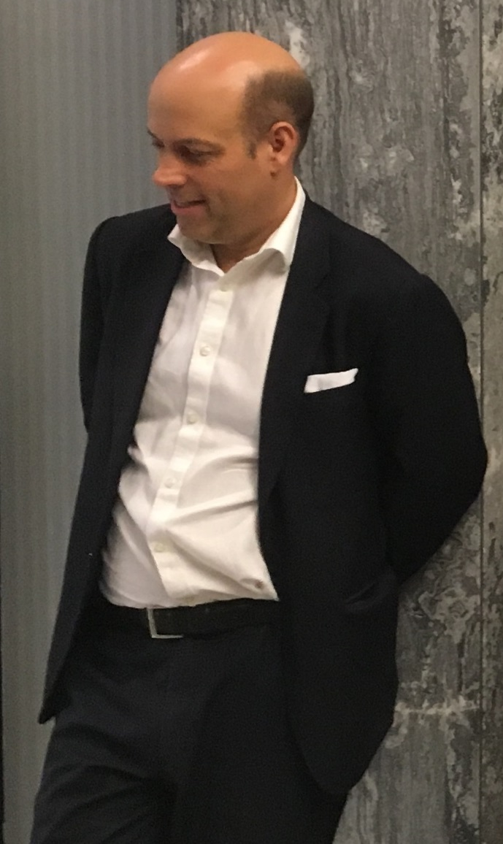
6. NEW BUSINESS
6.2 Call For New Business Items
www.csapsociety.bc.ca | ©Copyright 2019. Society of Contaminated Sites Approved Professionals of British Columbia.

Slide 9
7. INTRODUCTION OF THE 5 AT LARGE DIRECTORS
Congratulations to our new at-large Directors
www.csapsociety.bc.ca | ©Copyright 2019. Society of Contaminated Sites Approved Professionals of British Columbia.

Slide 10
THANK YOU To directors that have completed 2 terms and are stepping down.
Peter Reid
Andrew Sorensen
Patrick Johnstone
www.csapsociety.bc.ca | ©Copyright 2019. Society of Contaminated Sites Approved Professionals of British Columbia.

Slide 11
9. OFFICIAL CLOSING OF THE 2018-2019 ANNUAL GENERAL MEETING
The AGM portion of the day is now concluded. Thank you for attending.
www.csapsociety.bc.ca | ©Copyright 2019. Society of Contaminated Sites Approved Professionals of British Columbia.

