Slide 1
Question 1
CSAP Special Projects Update
Risk Management Decisions based on Ecological Risk-based Standards
Project Lead:
Beth Power, Azimuth Consulting
Notes:
BC is roughly 20 times the size of the Netherlands
Based on an inventory conducted in 2004 in the Netherland, there were approximately 425K potentially contaminated sites in the Neth., this number was reduced (through inv and rem) to approximately 260,000 by 2009
According to the BC Site Registry database, there are approximately XXX registered sites in BC
The Netherlands has a very long history of industrial use dating back to the Industrial Revolution in the 1700’s, whereas in BC, industrial development began later around the 1850’s, and to this day remains localized to major centers with large quantities of undeveloped lands remaining.
Based on the information presented by Yvo, the first true soil protection standards came into force in January 1983. In BC, of course, the CSR came in nearly 14 years later in Dec 1996, which gives the Dutch a bit of a head start compared to BC, but not as much as you might think, given their history

Slide 2
Risk Management Decision Framework for BC Contaminated Sites October 23 2019 Beth Power, Azimuth CSAP PD Workshop

Slide 3
Outline
Background
Project
Deliverables
Awareness!

Slide 4
Background
Numerical standards
Risk-based standards
HHRA: Clear definitions for HHRA (HQ < 1, ILCR < 1/100,000)
ERA: Need clear / functional criteria to distinguish acceptable from unacceptable effects
Notes:
Last bullet: What we have now has criteria, they just don’t work in many situations.

Slide 5
Background
BC ERA policy and technical guidance exists (e.g., EC₂₀), but interpretation has challenges, for example:
Oversimplified (e.g., 19% effect size vs. 21% )
Implications of ECx depend on assessment endpoint (e.g., population vs. organism)
No “one size fits all” effect size (e.g., mouse vs. moose)
ECx difficult to apply in weight-of-evidence
Notes:
For the audience, define what EC20 is….

Slide 6
Background
Work conducted 2014-2016 (2 phases)
Qualified Professionals &
Approved Professionals benefit from:
More structured process to review submissions
Guidance on defining acceptability of risks for ecological receptors
In support of Professional Judgement

Slide 7
Team
Azimuth project team
Technical working group
Angela Crampton
Patrick Allard
Beth Power
Heather Osachoff (“MOE”)
Tara Kennedy
Trish Miller
Sam Reimer
Scott Steer
Reidar Zapf-Gilje
Mike Rankin
Michael McLeay
Research Project funded by CSAP
David Williams, Project Sponsor

Slide 8
Deliverables
Flowchart - P6 review of ERA
Compilation by land use for protection goals
Descriptions of “risk”

Slide 9
P6 Decision Tool for Risk-based Std
1
2
3

Slide 10
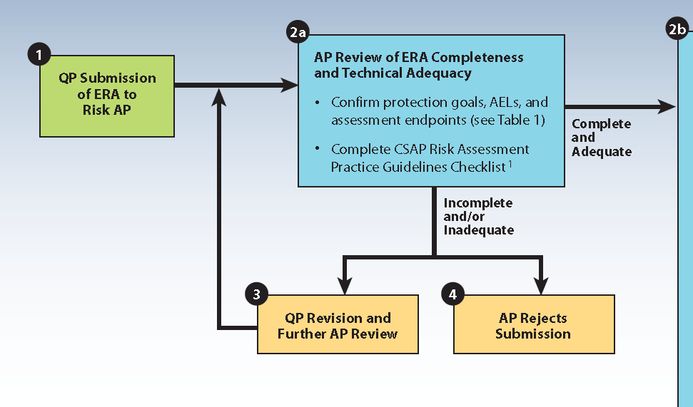
P6 Decision Tool for Risk-based Std

Slide 11
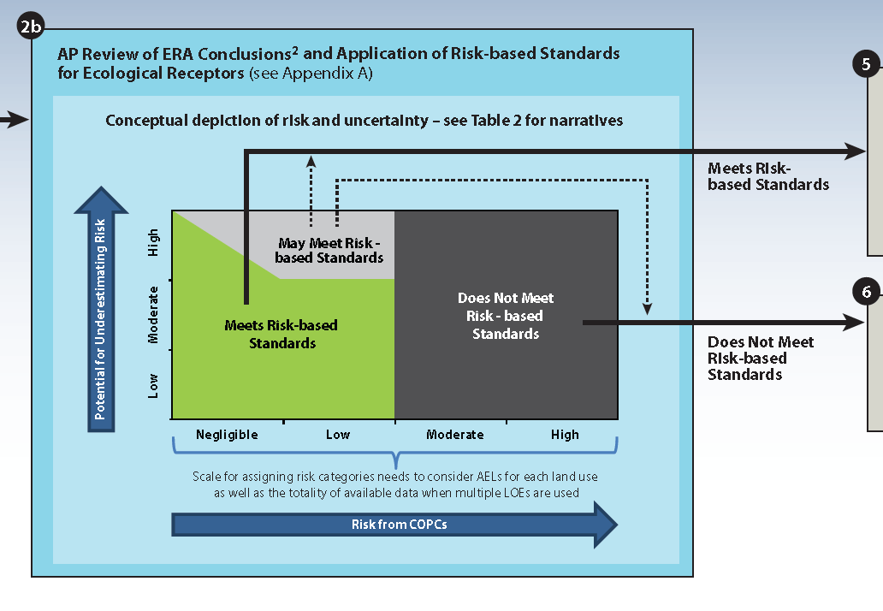
P6 Decision Tool for Risk-based Std

Slide 12
P6 Decision Tool for Risk-based Std

Slide 13
Protection Goals & Acceptable Effects Levels

Slide 14
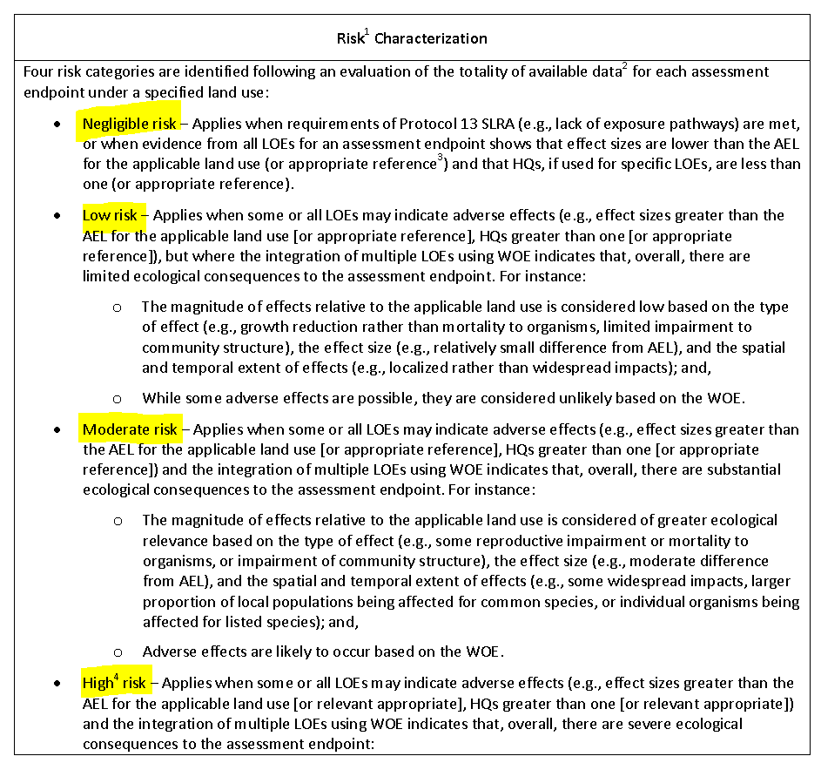

Slide 15
See also guidance on characterizing uncertainty

