Slide 1
PERFORMANCE
ASSESSMENT
COMMITTEE
Chair: Eva Gerencher, P.Ag., Director
Members:
Chuck Jochems, P.Eng. Ingo Lambrecht, P.Geo. Duncan Macdonald, P.Eng. Trish Miller, R.P.Bio. Dave Mitchell, Ph.D., P.Eng. Tara Siemens-Kennedy, P. Chem.
www.csapsociety.bc.ca | ©Copyright 2019. Society of Contaminated Sites Approved Professionals of British Columbia.

Slide 2
Performance Assessment Process
The PAC manages CSAP’s quality assurance process developed and implemented to ensure Approved Professional recommendations for legal instruments are prepared in accordance with the EMA and CSR and ENV’s protocols, procedures and guidance.
The overall goal of the performance assessment (PA) review is to confirm that the legal instrument application is accurate, complete and valid.
www.csapsociety.bc.ca | ©Copyright 2019. Society of Contaminated Sites Approved Professionals of British Columbia.

Slide 3
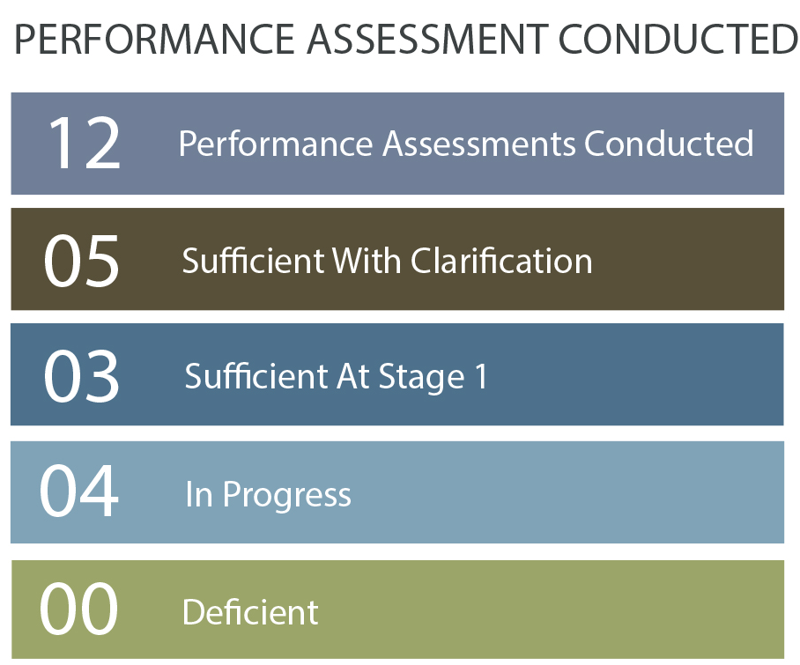
2018-19 Performance Assessment Statistics
www.csapsociety.bc.ca | ©Copyright 2019. Society of Contaminated Sites Approved Professionals of British Columbia.

Slide 4
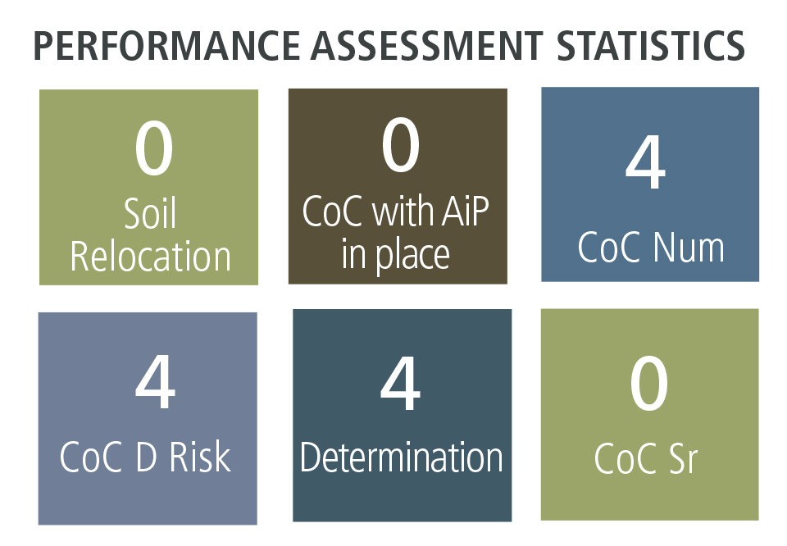
2018-19 Performance Assessment Statistics
www.csapsociety.bc.ca | ©Copyright 2019. Society of Contaminated Sites Approved Professionals of British Columbia.

Slide 5
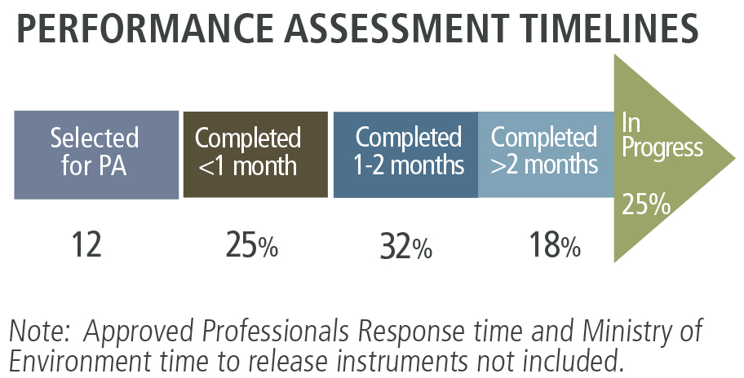
2018-19 Performance Assessment Statistics
www.csapsociety.bc.ca | ©Copyright 2019. Society of Contaminated Sites Approved Professionals of British Columbia.

Slide 6
Committee Updates
Completed all performance assessments for pre-Omnibus AP recommendations
Updated the Guidelines for Performance Assessment and Detailed Screening
Document “lessons learned” from each performance assessment
Provide quarterly updates in the Membership newsletter
www.csapsociety.bc.ca | ©Copyright 2019. Society of Contaminated Sites Approved Professionals of British Columbia.

Slide 7
Committee Updates
Professional Reliance Review Recommendation (R.42) to improve transparency between ENV and CSAP
ENV engagement with PAC to review the performance assessment process for completeness, transparency and consistency of results and accountability
CSAP implemented enhanced reporting for PA findings
Panel Final Findings reports for sufficient submissions
Rationale and remedial measures for deficient submissions
www.csapsociety.bc.ca | ©Copyright 2019. Society of Contaminated Sites Approved Professionals of British Columbia.

Slide 8
Closing Remarks
The PAC is committed to continuous improvement to ensure that the PA process is fair, equitable and transparent.
We value the feedback of CSAP members and stakeholder and encourage your continued input through surveys and comments.
www.csapsociety.bc.ca | ©Copyright 2019. Society of Contaminated Sites Approved Professionals of British Columbia.

Slide 9
THANK YOU

