Slide 1
TECHNICAL
REVIEW
COMMITTEE
Chair: Beth Power, M.Sc., R.P.Bio., Director
Members:
Gary Lin, P.Eng. | Jeff Taylor, P.Eng.
Ian Mitchell, P.Geo. | Christine Thomas, R.P.Bio.
Guy Patrick, M.Sc., P.Eng.
www.csapsociety.bc.ca | ©Copyright 2019. Society of Contaminated Sites Approved Professionals of British Columbia.

Slide 2
Technical Review Committee
Technical Reviews
Small Special Project Funding Program
Other technical issues
Scholarship Program
www.csapsociety.bc.ca | ©Copyright 2019. Society of Contaminated Sites Approved Professionals of British Columbia.

Slide 3
2018/19 Special Projects
Review draft of Toolkit #3: Framework for Evaluation of Remediation Options for Petroleum Hydrocarbon Sites – Remedial Technology Toolkit (under review)
Review draft of Toolkit #4: Methods & Tools for Sustainable Remediation of Petroleum Hydrocarbon Sites (under review)
Leachate Test Verification -Laboratory Evaluation of Leachate Tests (under review)
www.csapsociety.bc.ca | ©Copyright 2019. Society of Contaminated Sites Approved Professionals of British Columbia.

Slide 4
2018/19 Technical Reviews
Summary for ENV of vapour scenarios with high risk conditions
Contaminated Soil Relocation Q&A (pending)
Operational definition of where sensitive and typical sediment quality standards apply (pending)
Consolidated CSAP Questions & Answers (now on-line)
www.csapsociety.bc.ca | ©Copyright 2019. Society of Contaminated Sites Approved Professionals of British Columbia.

Slide 5
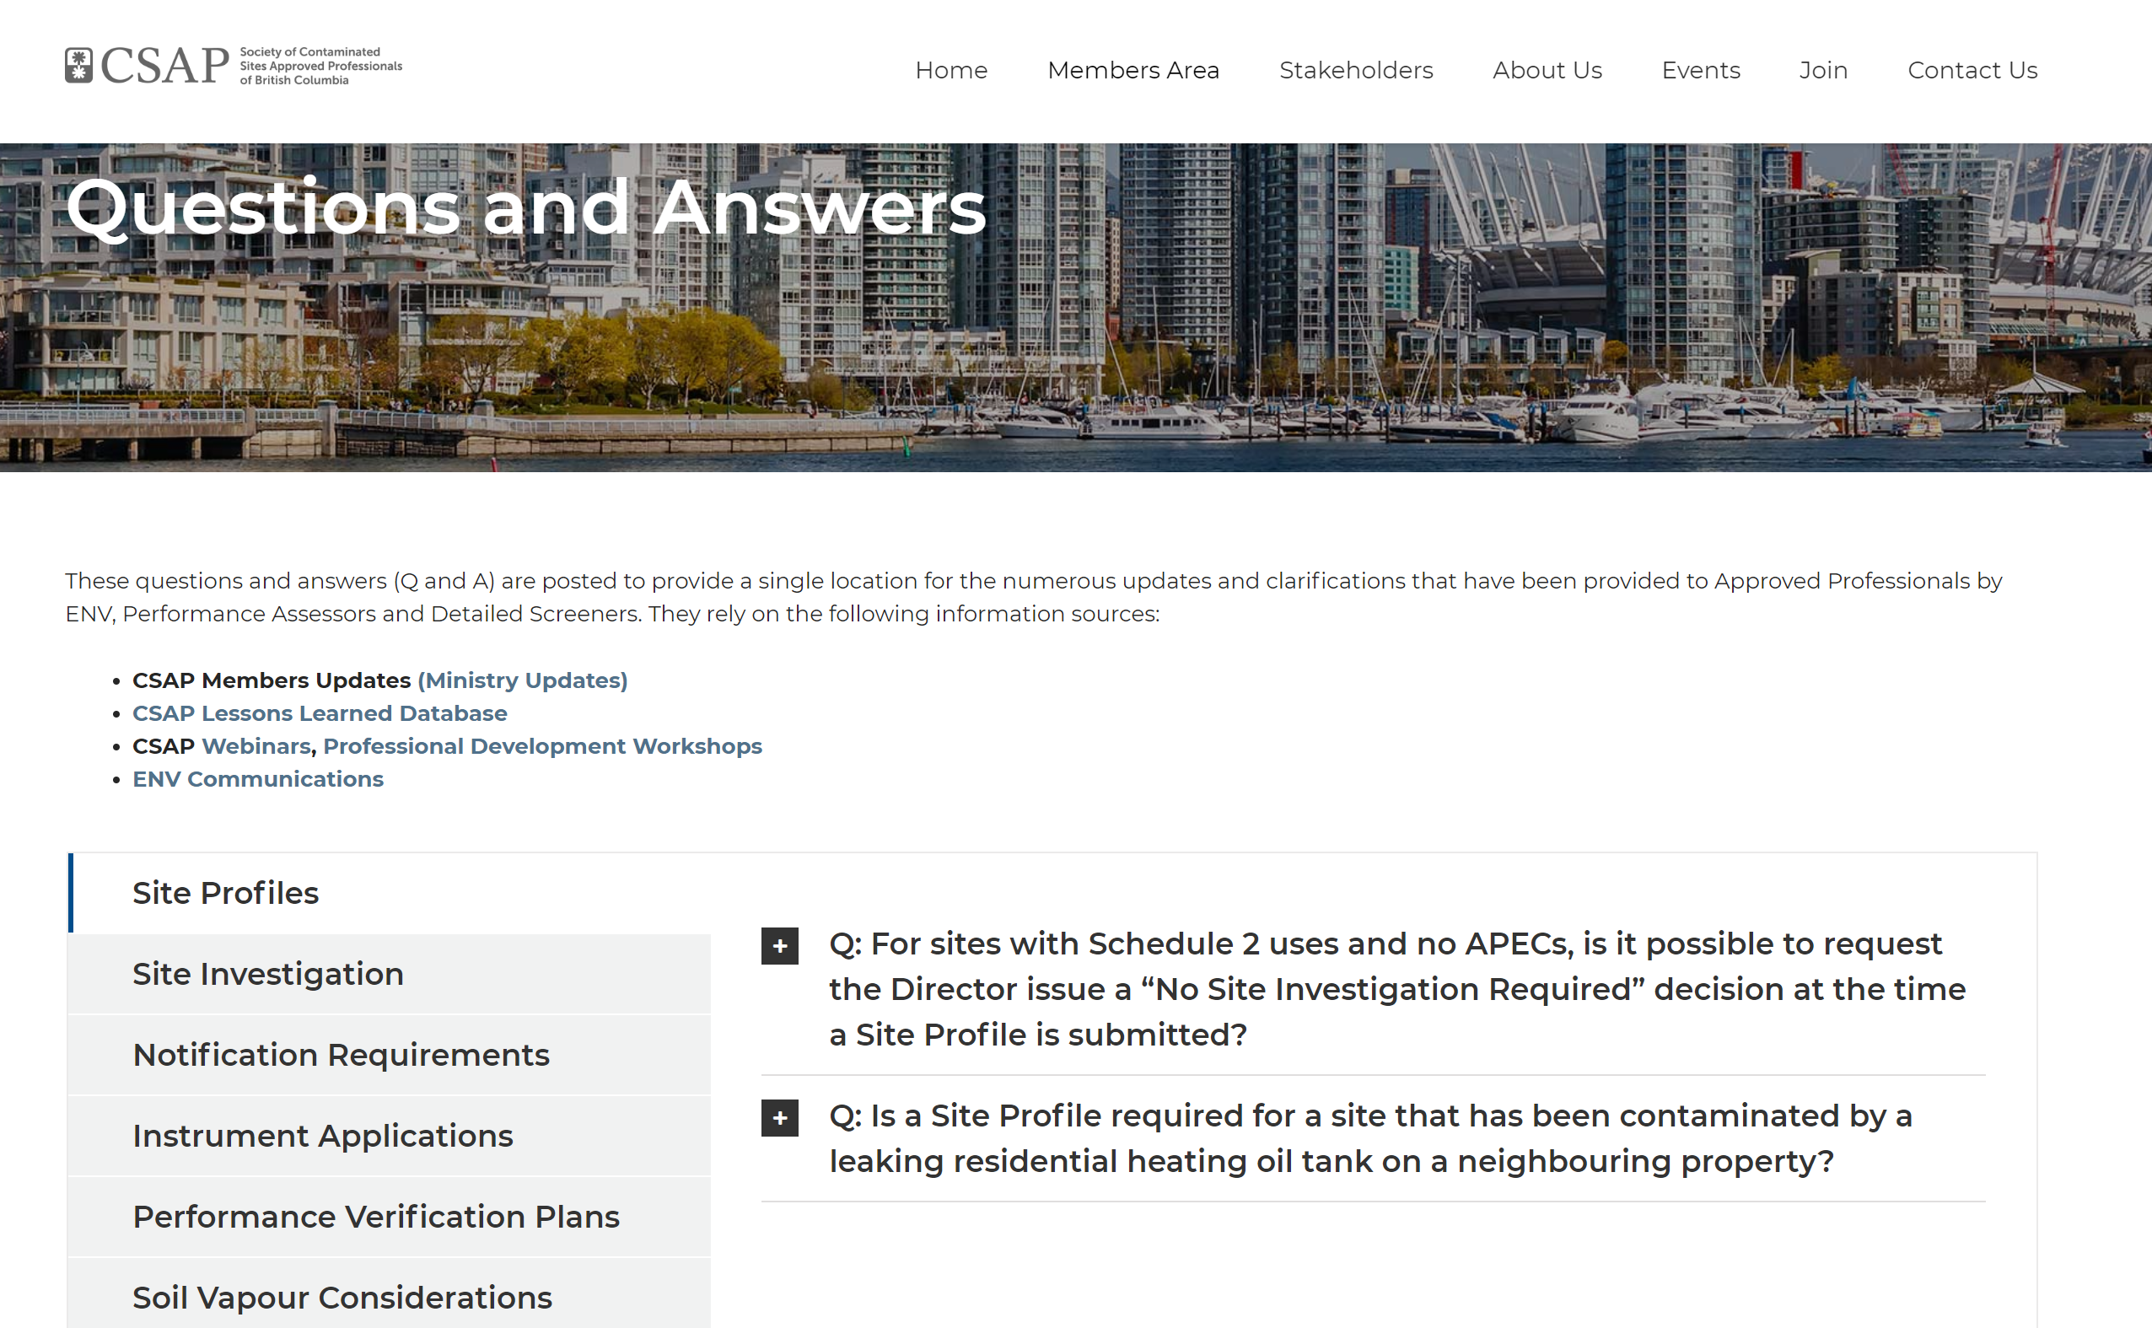

Slide 6
THANK YOU
A year of completion…

