Slide 1
Application of Sensitive vs Typical Sediment Standards
CSAP Fall AGM
Presented by
Christine Thomas, Golder
25 October 2019
Notes:
This topic was raised and was brought to the TRC as there had been several questions from practitioners about when it would be suitable to use the typical vs sensitive, as there was some uncertainty in the interpretation of the definitions as they were currently presented in the CSR

Slide 2
Working Group Team Members
Patrick Allard - Azimuth
Meara Crawford - Azimuth
Beth Power - Azimuth
Trish Miller - TAM Environmental Ltd.
Tara Siemens Kennedy - SNC-Lavalin Inc.
Christine Thomas - Golder

Slide 3
The problem
Review definitions
Approach
Recommendations
Notes:
What is the problem that practitioners had identified
Summarize our approach to this issue
Hasn’t been reviewed by ENV
ENV did indicate the other day that it would be very difficult/would take time for them to change the CSR definitions (requires legislative approval). I suggested to Beth that a workaround might be for ENV to provide guidance using our recommendations and the original intent of the typical standards.

Slide 4
The Problem
Since introduced in 2003 there have been some changes and uncertainty in interpretation and application of sensitive vs typical
Based on current definition, sensitive sediment is being interpreted as applying at the majority of contaminated sites, with typical standards being rarely used
Notes:
It was outlined in the CMCS what would be typical and what would sensitive and it was fairly clear when you could apply typical. Since then we have migrated from origina definition in CMCS and relied more on the defn in the CSR and Procedure 8

Slide 5
Objective
As per BC ENV request, develop an operational definition and examples of “sensitive use” vs “typical use” in the context of BC CSR sediment quality standards

Slide 6
Current Definitions
Typical
Typical sediment use means the use of a site containing sediment for a use that is not a sensitive sediment use
Notes:
No real information on what a typical site would look like and so default is that you would have to confirm that your sediments are not sensitive before typical would apply
The definition is silent on what types of sites would be considered typical

Slide 7
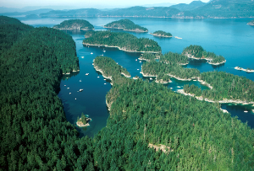
Current Definitions
Sensitive
sensitive sediment use means the use as habitat for sensitive components of freshwater, marine or estuarine aquatic ecosystems of a site containing sediment, which sensitive components include, but are not limited to,
(a) phytoplankton, zooplankton, benthos, macrophytes and fish,
(b) habitats used by endangered or threatened species or species of special concern under the Species at Risk Act (Canada),
(c) watercourses, wetlands, forested riparian areas, mudflats and intertidal zones that are important to the preservation of fish or wildlife,
(d) reaches of aquatic habitats that are important to fish spawning or serve as important rearing habitat for fish,
(e) reaches of aquatic environments that encompass or border habitat compensation or restoration sites or other areas that are intended or designed to create, restore or enhance biological or habitat features, and
(f) areas and aquatic habitat included in wild life management areas designated under the Wildlife Act
Notes:
-Definition does not take into consideration use of water lots for active commercial or industrial operations (e.g., wharves, marinas)
-The first bullet defining sensitive includes all classes of aquatic organisms, precludes use of typical unless further habitat assessment is done. Also some words such as important can be ambiguous
-Isn’t user friendly as it warrants evaluation of sediment by a biologist to determine which std applies

Slide 8
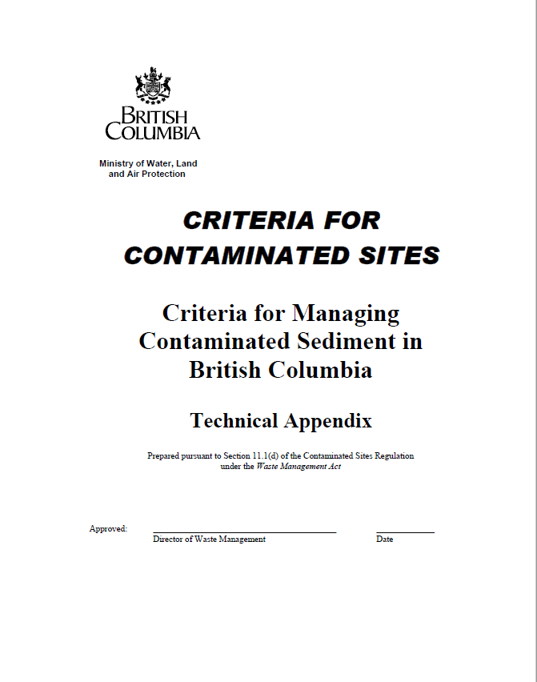
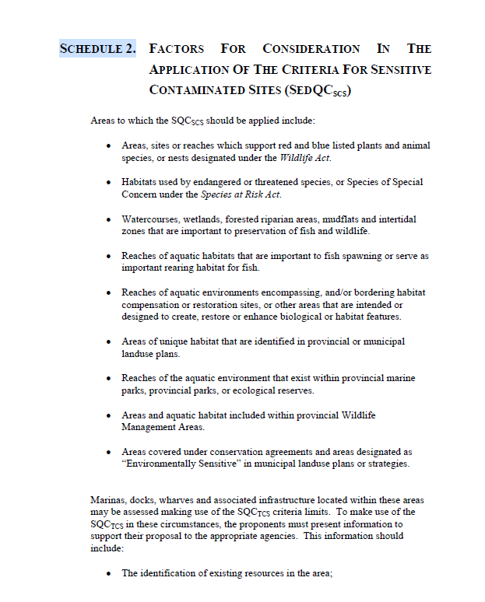
Approach
Reviewed several relevant ENV documents
Considered ENV Policy on the derivation of other environmental quality standards
Definitions should be:
Sufficiently conservative (not over or under)
Straightforward and simple to understand and apply by environmental Professionals
Marinas, docks, wharves and associated infrastructure located within these areas
may be assessed making use of the typical sediment criteria limits.
Notes:
Mention CMCS and Schedule 2, Procedure 8
Not too conservative that we are applying the most sensitive stds at all of our sites
Straightforward so that these can be applied by any EP on project without requiring special expertise. This was part of the problem with current definiationn as it was difficult to argue it wasn’t sensitive unless you engaged with a biologist early on in the investigation

Slide 9
Review of Soil Ecological Standards
Landuses
Effect Level
= The acceptable magnitude of effects
Natural Wildland (WL_{N})
Reverted Wildlands (WL_{R})
Agricultural (AL)
Parkland (PL)
Residential low density (RL_{LDR})
Residential high density (RL_{HDR})
Commercial (CL)
Industrial (IL)
Land use | WL_{N} | WL_{R}/ AL/ PL/ RL_{LDR} | RL_{HDR}/ CL/ IL
Effect level | 15% | 25% | 50%
Notes:
is the magnitude (or rate) of effects that would be acceptable for a specific measurement endpoint or assessment endpoint.
Relative to some kind of control or background

Slide 10
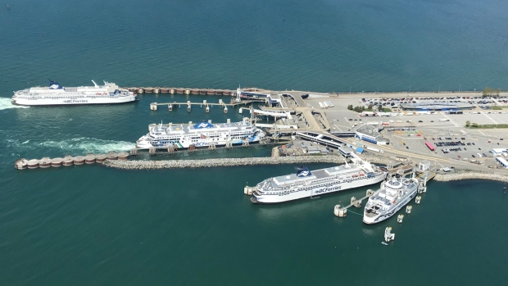
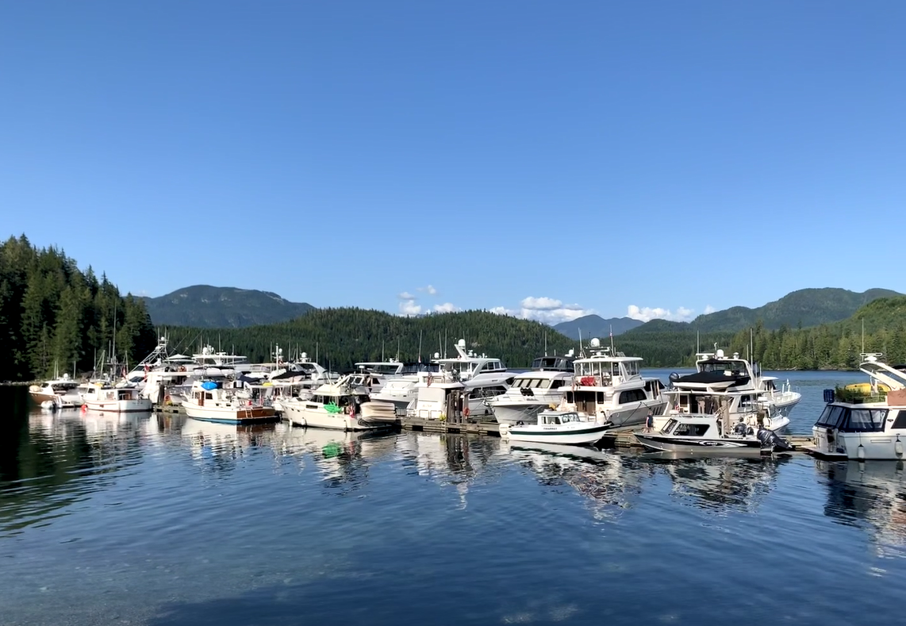
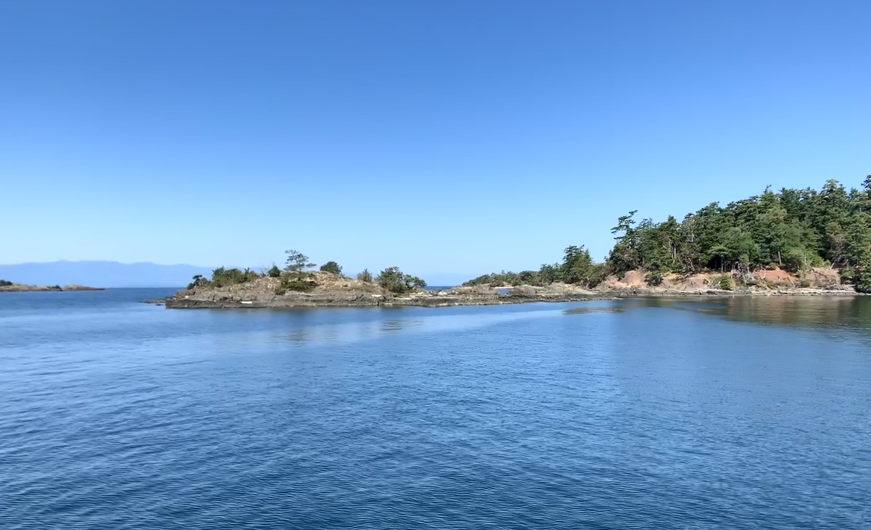
Review of Sediment Aquatic Life Standards
Landuses - no differentiation for sediment
Effect level is 20%

Slide 11
Review of Sediment Aquatic Life Standards
Difference in sensitive vs typical is not in the effect level magnitude, but the probability of a 20% effect level occurring (i.e. EC20):
Sensitive - <20% probability of observing an EC20
Typical - >50% probability of observing an EC20

Slide 12
Outcome of Review
varying levels of protection are allowed dependent on the intended use of the environment (landuse).
Landuse definitions include some CL/IL type of uses for waterlots and sediments e.g., commercial land use includes air and sea terminals, and definition of industrial land use includes hydroelectric dams and wastewater and sewage treatment plants
Notes:
So even though we don’t have CL sediment stds, we define some commercial and industrial type activities tha would impact a water lot

Slide 13
Recommendations
Typical definition
Original: typical sediment use means the use of a site containing sediment for a use that is not a sensitive sediment use
Recommendation: typical sediment use means the use of a water lot site associated with active commercial or industrial operations (e.g., marinas, wharves, shipping, communications)
Notes:
Recommendations:
Recommended definitions of sensitive and typical sediments are adapted from Schedule 2, “Factors for consideration in the application of the criteria for sensitive contaminated sites”, in the Criteria for Managing Contaminated Sediment in British Columbia Technical Appendix (ENV undated3).

Slide 14
Recommendations
Original
sensitive sediment use means the use as habitat for sensitive components of freshwater, marine or estuarine aquatic ecosystems of a site containing sediment, which sensitive components include, but are not limited to,
(a) phytoplankton, zooplankton, benthos, macrophytes and fish,
(b) habitats used by endangered or threatened species or species of special concern under the Species at Risk Act (Canada),
(c) watercourses, wetlands, forested riparian areas, mudflats and intertidal zones that are important to the preservation of fish or wildlife,
(d) reaches of aquatic habitats that are important to fish spawning or serve as important rearing habitat for fish,
(e) reaches of aquatic environments that encompass or border habitat compensation or restoration sites or other areas that are intended or designed to create, restore or enhance biological or habitat features, and
(f) areas and aquatic habitat included in wild life management areas designated under the Wildlife Act
(a) phytoplankton, zooplankton, benthos, macrophytes and fish,
(g) designated marine or aquatic park or Marine Protected Area.
Notes:
-Definition does not take into consideration use of water lots for active commercial or industrial operations (e.g., wharves, marinas)
-The first bullet defining sensitive includes all classes of aquatic organisms, precludes use of typical unless further habitat assessment is done. Also some words such as important can be ambiguous
-Isn’t user friendly as it warrants evaluation of sediment by a biologist to determine which std applies

Slide 15
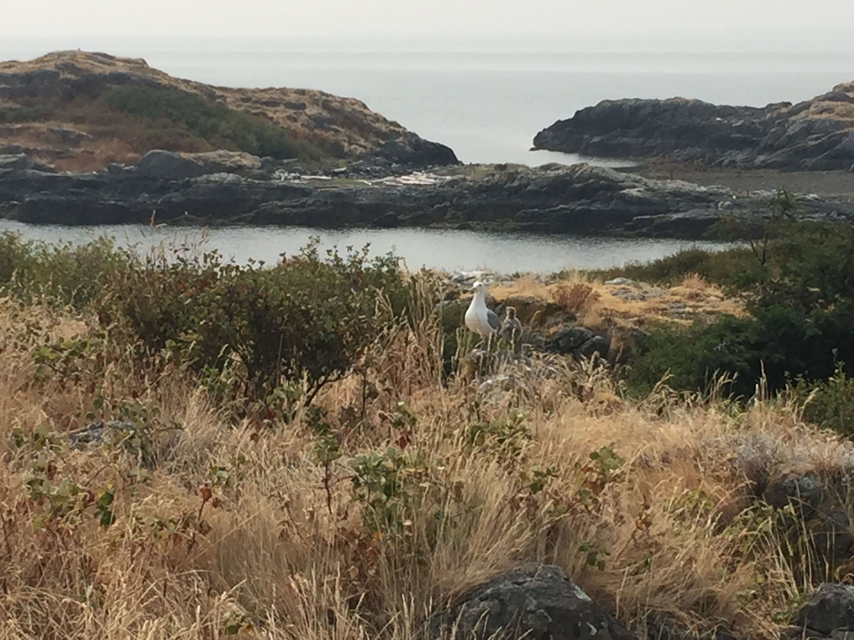
Examples
typical
Sensitive
Sediments having structures such as docks/piers extending into the waterlot and operated for commercial/industrial purposes (e.g., Harbours, shipyards, marinas, ferry terminals)
Any sediments that are not considered “typical” sediment
Notes:
Marina - This is conceptually similar to where allowances are made for active beneficial use. Chemically treated dock structures and physical alteration associated with prop wash, for example, impact on the environment. This situation is analogous to allowing a lower level of protection at a gas station operating within a national park where a higher level of protection applies.
This was also stated in original Tech guidance - Marinas, docks, wharves and associated infrastructure located within these areas may be assessed making use of the SQCTCS criteria limits.

Slide 16
Thank-you!
Questions?

